Slide 1
Writers Face Censorship
Most, but not all, government and church authorities felt they had a sacred duty to defend the old order. They believed that God had set up the old order.
To protect against the attacks of the Enlightenment, they waged a war of censorship, or restricting access to ideas and information. They banned and burned books and imprisoned writers.
To avoid censorship, philosophes and writers like Montesquieu and Voltaire sometimes disguised their ideas in works of fiction.

Slide 2
Enlightenment Ideas Spread to Salons
New literature, the arts, science, and philosophy were regular topics of discussion in salons, or informal social gatherings at which writers, artists, philosophes, and others exchanged ideas.
The salon originated in the 1600s, when a group of noblewomen in Paris began inviting a few friends to their homes for poetry readings.
By the 1700s, some middle-class women began holding salons. Here middle-class citizens could meet with the nobility on an equal footing to discuss and spread Enlightenment ideas.

Slide 3
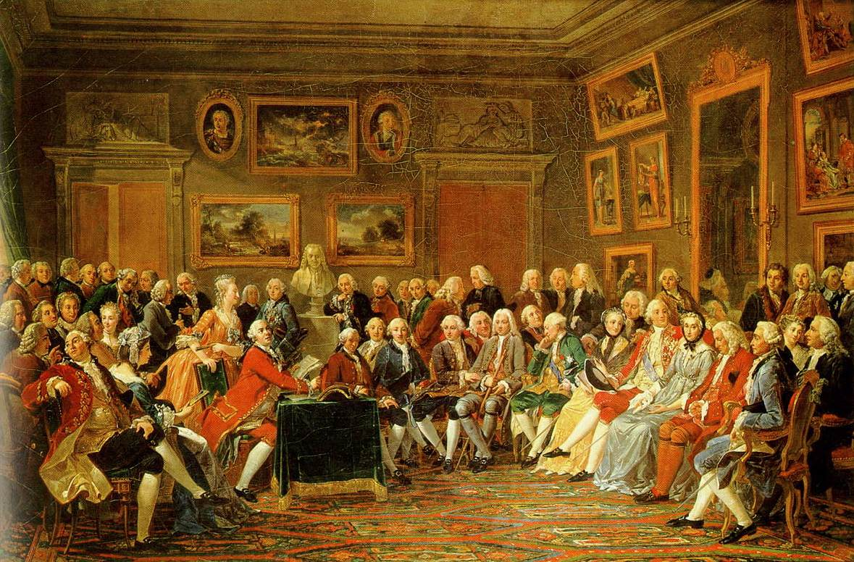

Slide 4
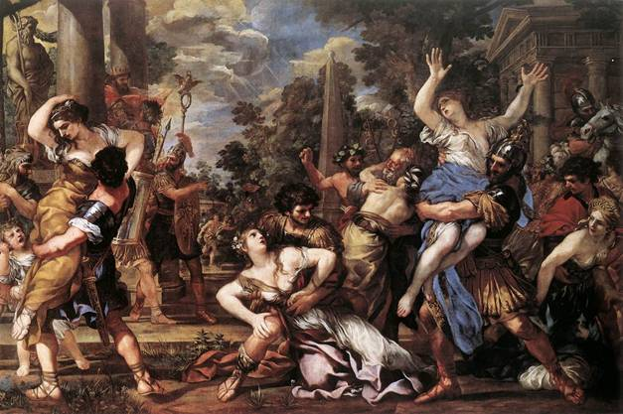

Slide 5
Baroque Style
Baroque style – courtly art and architecture in the Greek and Roman tradition or in the grand ornate style.
Huge, colorful and full of excitement.
They glorified historic battles or the lives of saints.

Slide 6
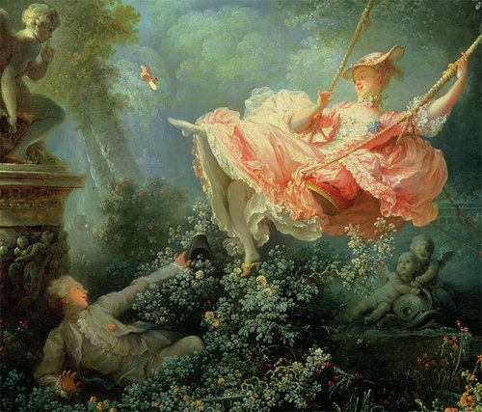

Slide 7
Rococo Style
Rococo style – moved away from religion and, unlike the heavy splendor of the baroque, was lighter, elegant, and charming.
Rococo art in salons was believed to encourage the imagination.
More pastel colors were used.
Portrait painters showed noble subjects in charming rural settings, surrounded by happy servants and pets.

Slide 8
Composers
The new Enlightenment ideals led composers and musicians to develop new forms of music that transformed into what we call today “classical.”
Ballets and operas—plays set to music—were performed at royal courts, and opera houses sprang up from Italy to England.
Before this era, only the social elite could afford to commission musicians to play for them. In the early to mid-1700s, however, the growing middle class could afford to pay for concerts to be performed publicly.
Among the towering musical figures of the era:
Franz Joseph Haydn
Wolfgang Amadeus Mozart

Slide 9
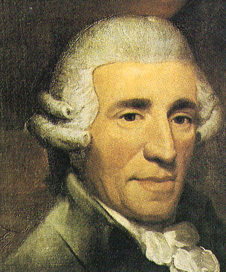
Franz Joseph Haydn
1732 - 1809
One of the most important figures in the development of classical music. Helped develop forms for the string quartet and the symphony.

Slide 10
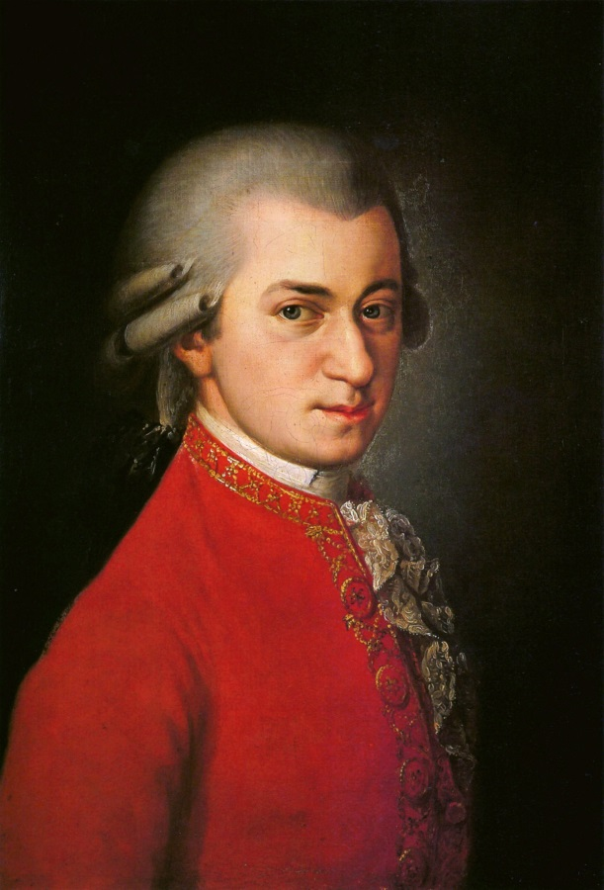
Wolfgang Amadeus Mozart 1756-1791
Mozart was a child prodigy who gained instant celebrity status as a composer and performer. His brilliant operas, graceful symphonies, and moving religious music helped define the new style of composition.

